Slide 1
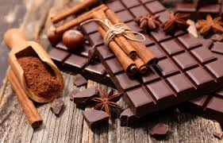
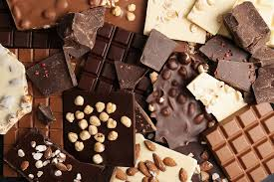
Chocolate paradise cafe
we have a lot of chocolate desserts here.
Open 7.00-20.00

Slide 2
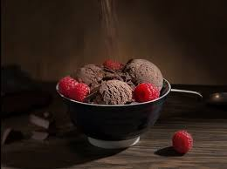
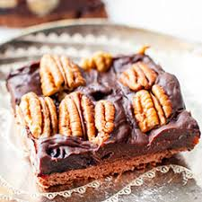
Dessert menu
1 chocolate-berry cake with orange
2 cupcake with milk chocolate inside
3 fruit salad with white chocolate
4 chocolate ice cream
5 apple in chocolate
6 pancakes with chocolate
7 chocolate souffle
8 chocolate pudding
9 marshmallows with liquid chocolate
10 chocolate cake with nuts
11 chocolate cookies
12 banay in chocolate

Slide 3
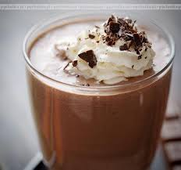
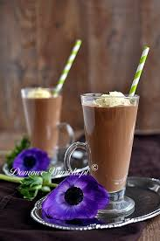
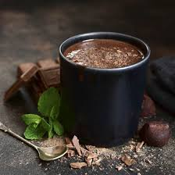
Drinks menu
1chocolate and banana cocktail
2chocolate and berries cocktail
3 chocolate milk
4 hot chocolate
5 hot chocolate with fruit and whipped cream
6 hot white chocolate
7 chocolate caffé
8 chocolate coffee with ice cream

Slide 4
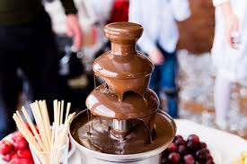
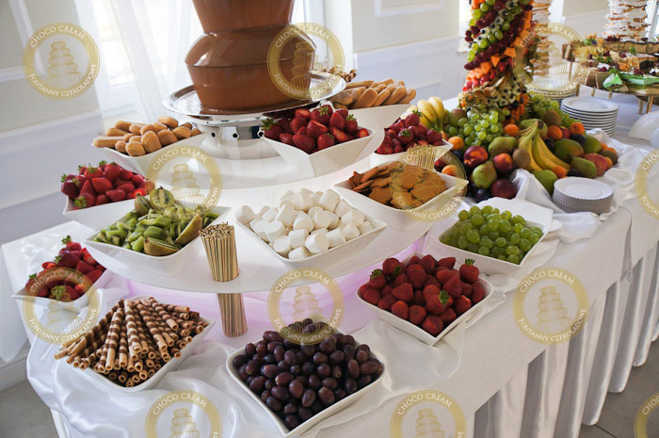
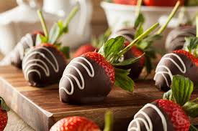
There is a chocolate fountain in the middle of our fruit table cafe and everyone in the restaurant can use it

