Slide 1
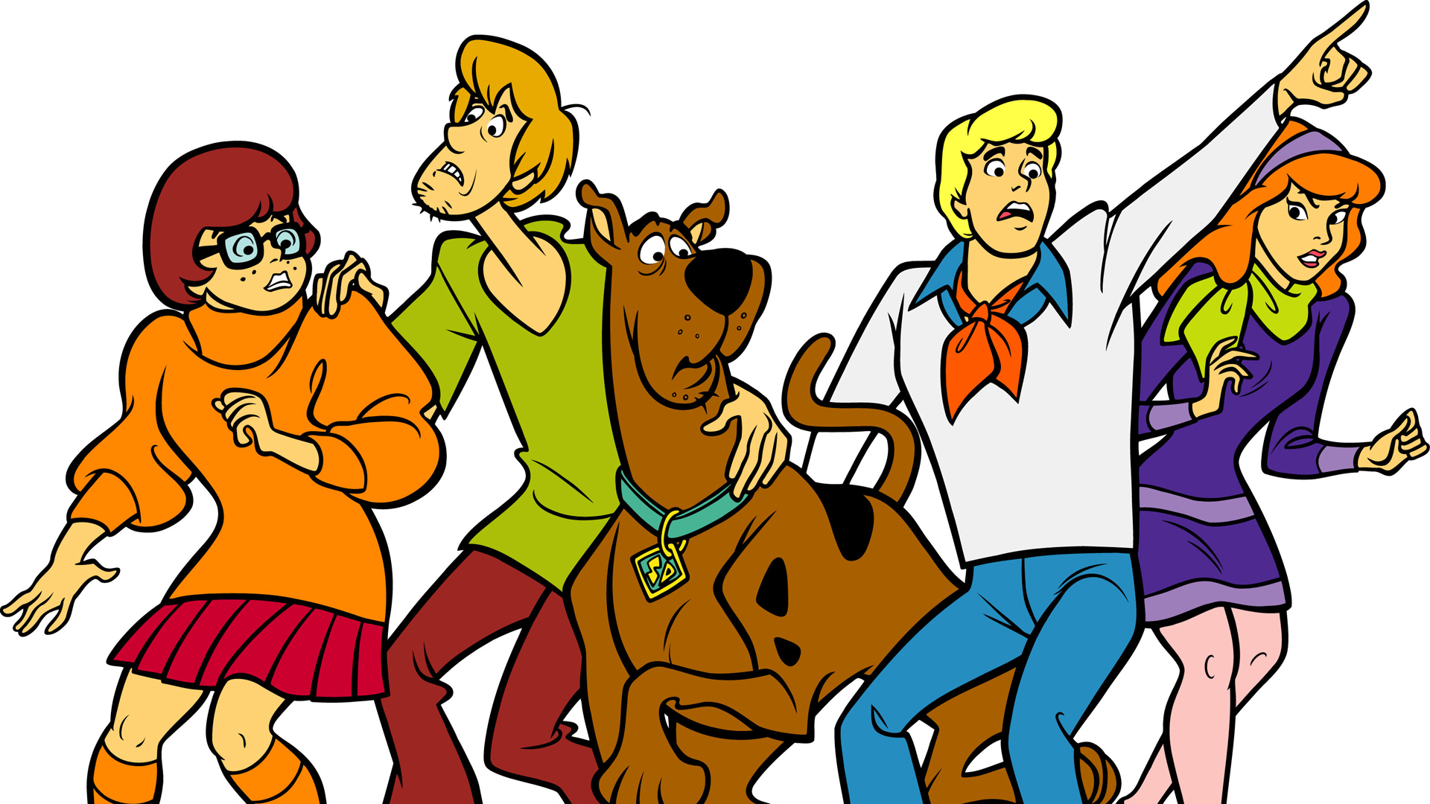
SCOOBY DOO - THE BEST SERIES IN THE WORLD

Slide 2
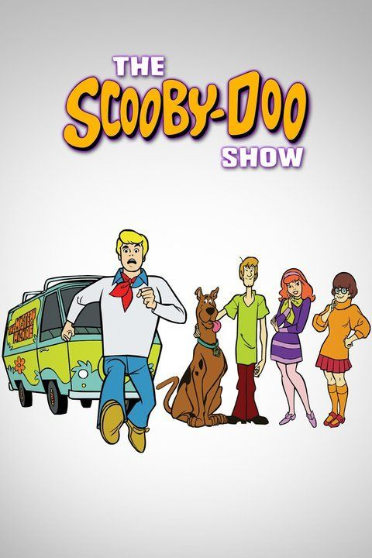
GENERAL INFORMATION
COUNTRY OF PRODUCTION: United States
ORIGINAL LANGUAGE: English
TYPE: Animated series
CREATORS:Joe Ruby, Ken Spears

Slide 3
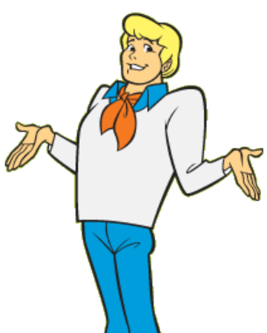
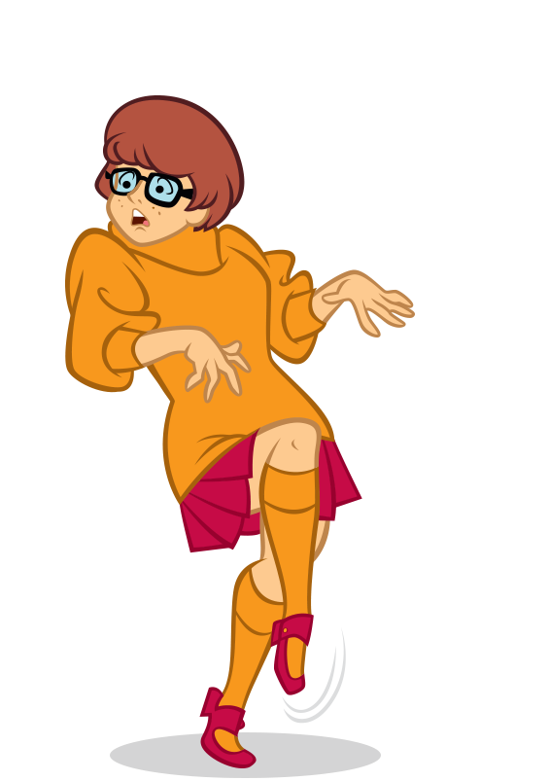
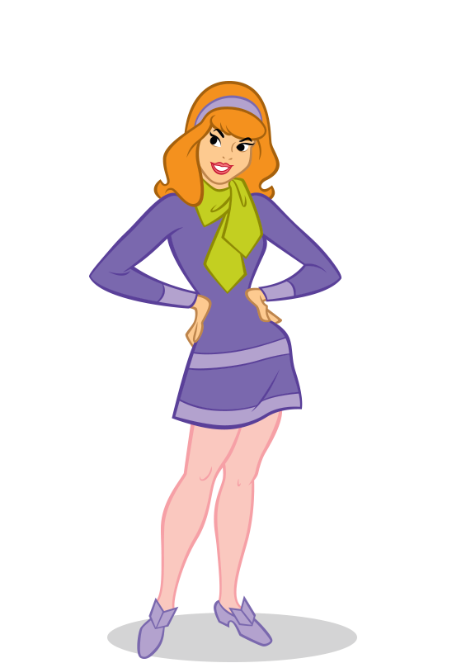
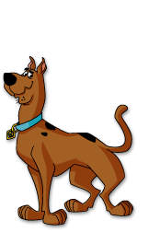
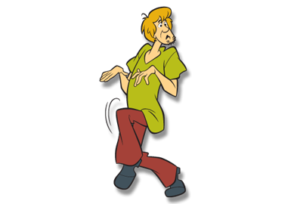
MAIN ROLES
Daphne Blake
Velma Dinkley
Fred Jones
Shaggy Rogers
Scoobert „Scooby” Doo

Slide 4
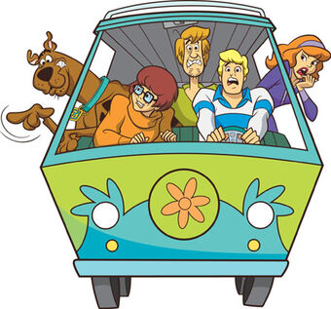
WHAT IS ABOUT ?
This serials is about friends : Fred, Velma, Daphne, Shaggy and their faithful, but very cowardly dog ​​- Scooby- Doo. Experience many adventures together. They travel in a characteristic van, searching for dark adventures and criminal mysteries that they always try to solve.During the quest, Scooby-Doo and Shaggy always try to hide somewhere from monsters. Sympathetic, but clumsy and timid quadruped seemingly is not suitable as a hunter of all kinds of ghosts and ghosts from the world of ghosts and the most real criminals. However, with the help of friends, he always gets out of trouble and after solving a difficult puzzle, he can indulge in his second favorite occupation with Shaggy, namely gluttony. Despite clumsiness they always find the explanation of puzzles and then they become real heroes.

Slide 5
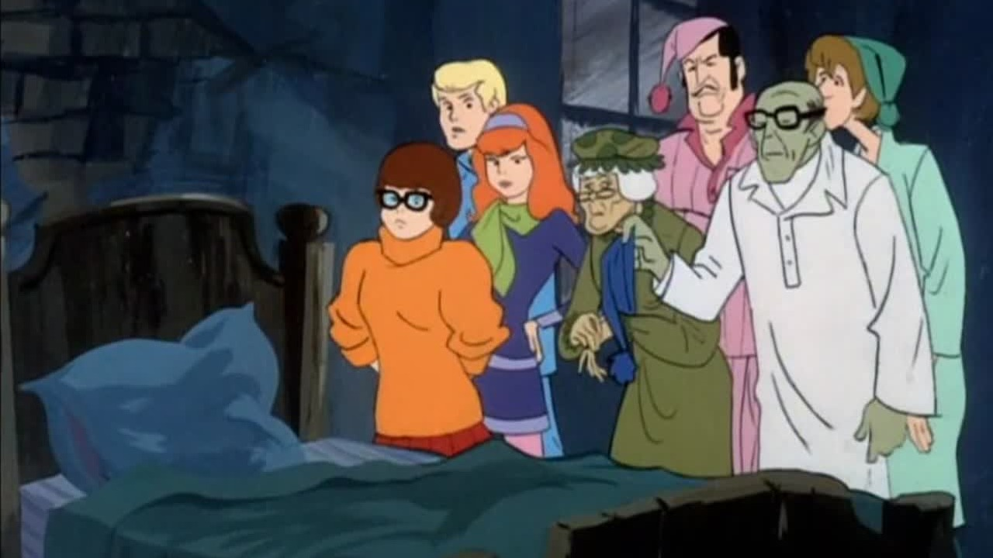
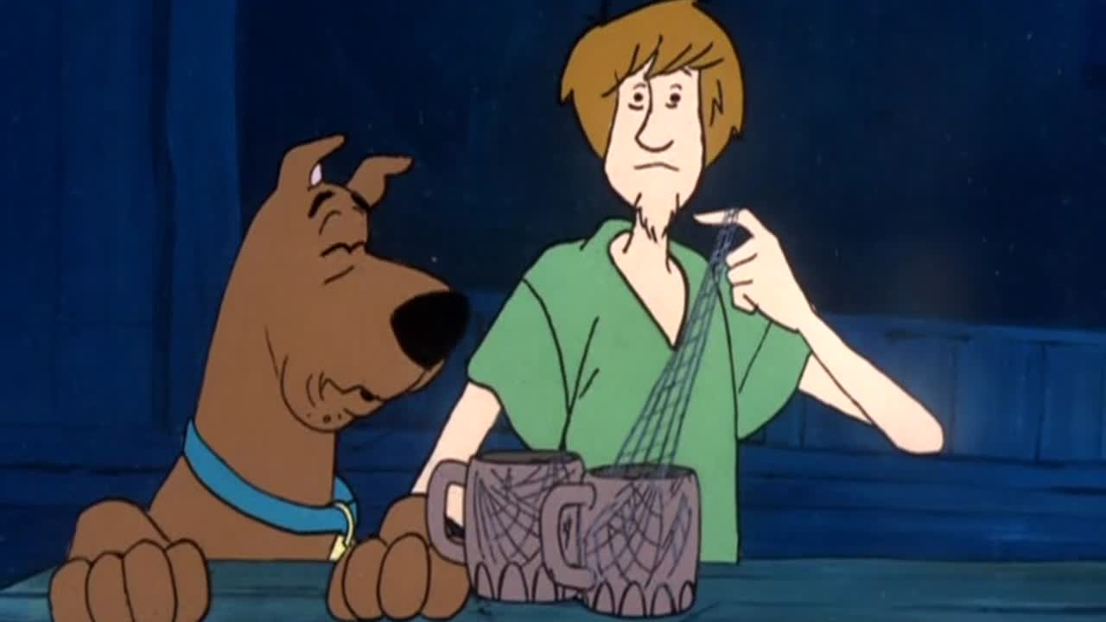
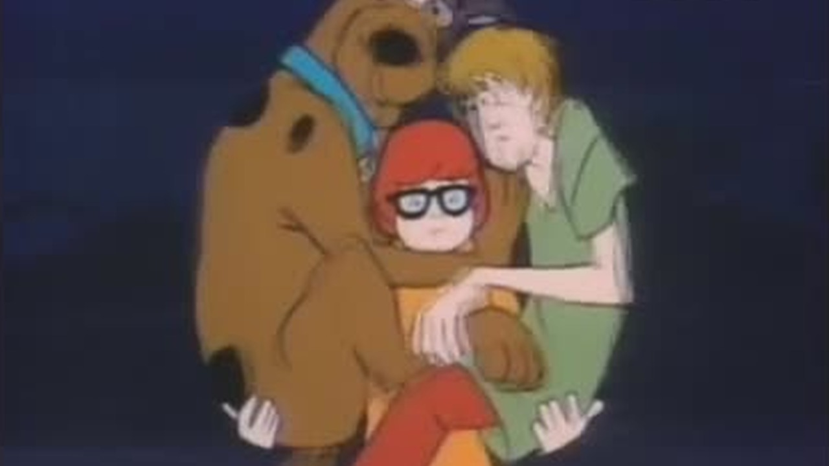
HOW OFTEN DO YOU WATCH IT ?
I watched all the episodes, but this series is the best so I watch this again. I don’t have much times and I watch twice a week.

Slide 6
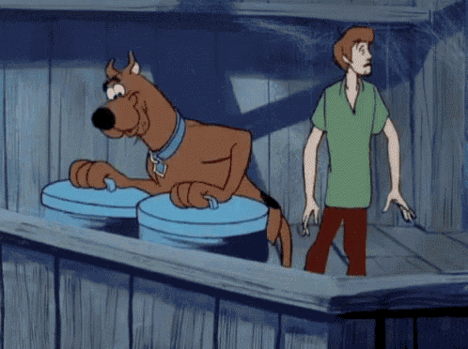
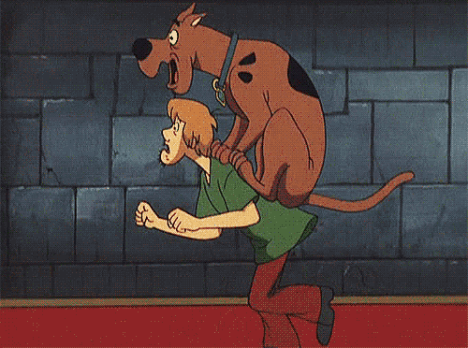
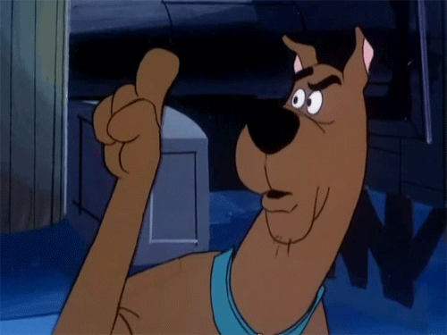
WHY I LIKE IT ?
I like it because it is very funny cartoon. My favourite heroes is shaggy and scooby because are funny. They always are afraid but despites he solves riddle with help. I like detective threads in this series. In this series is amazing vibe and cool graphics.

