Slide 1
NOMADIC PPEOPLE
people still on the way home

Slide 2
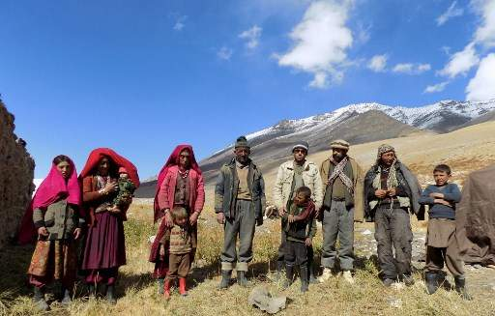
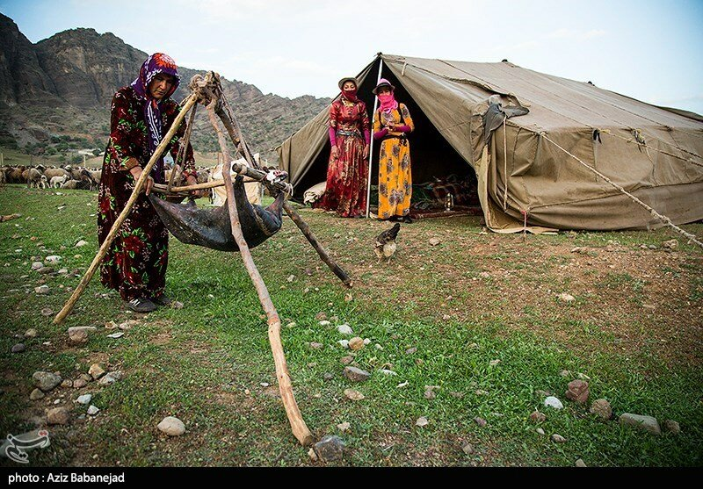
Who they are?
A member of a community without fixed habitation which regularly moves to and from the same areas
In 1995 were 30-40 millon nomands in the world
Notes:
Wstaw mapę kraju.

Slide 3
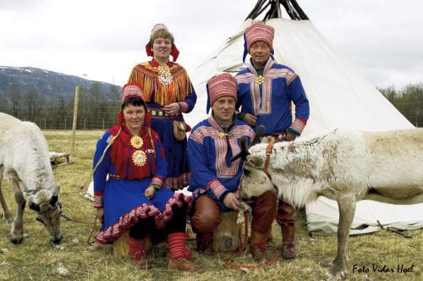
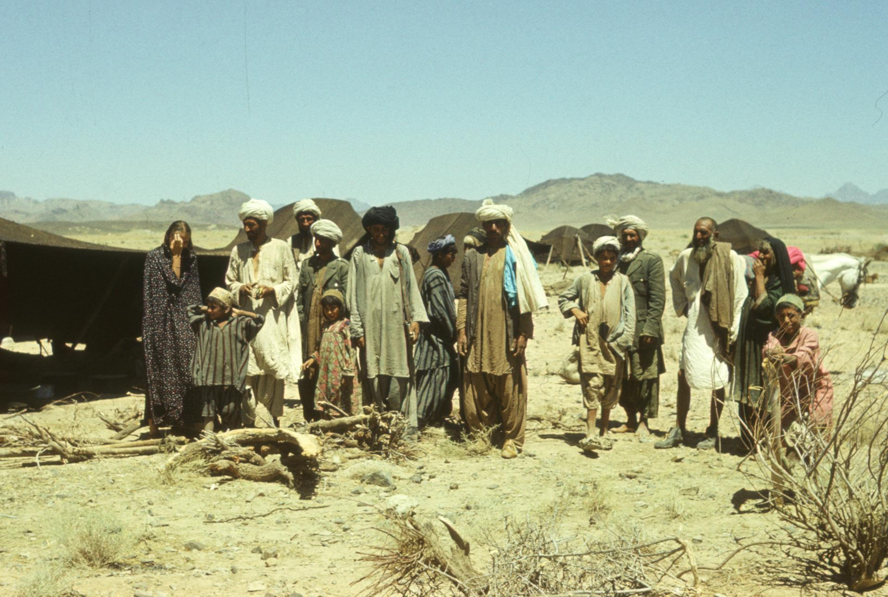
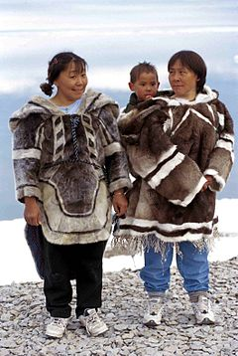
Groups of nomadic people
Bedouins → Jordan ( Africa)
Roma → Europe, North America
Tuareg → Algieria, Libya, Niger ( Sahara, Arfica)
Innuites → Canada, Alasca, Grenland
Pygmies → tropical forests (Africa)
Bushmen → Namibia ( Africa)
Aborigens → Australia
Lapandres → Lapland ( north of Norway, Finland, Russia)
Chuchki people → Russia (Asia part)
Notes:
Wstaw obraz przedstawiający porę roku w kraju.

Slide 4
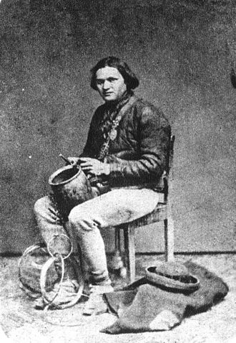
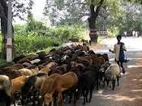
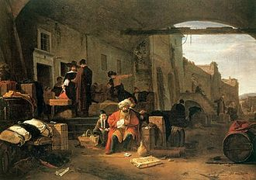
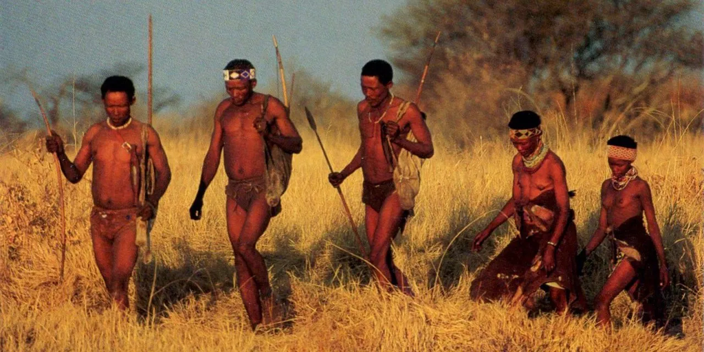
Roles in the nomand trible:
Hunter gatherer- they were looking for food by hunting
Pastorialism- they took care of the flock ( depending the trible and region)
Tinker- an itinerant tinsmith who fix household utensils
Merchant- they traded and bought the necessary things from other tribes

Slide 5
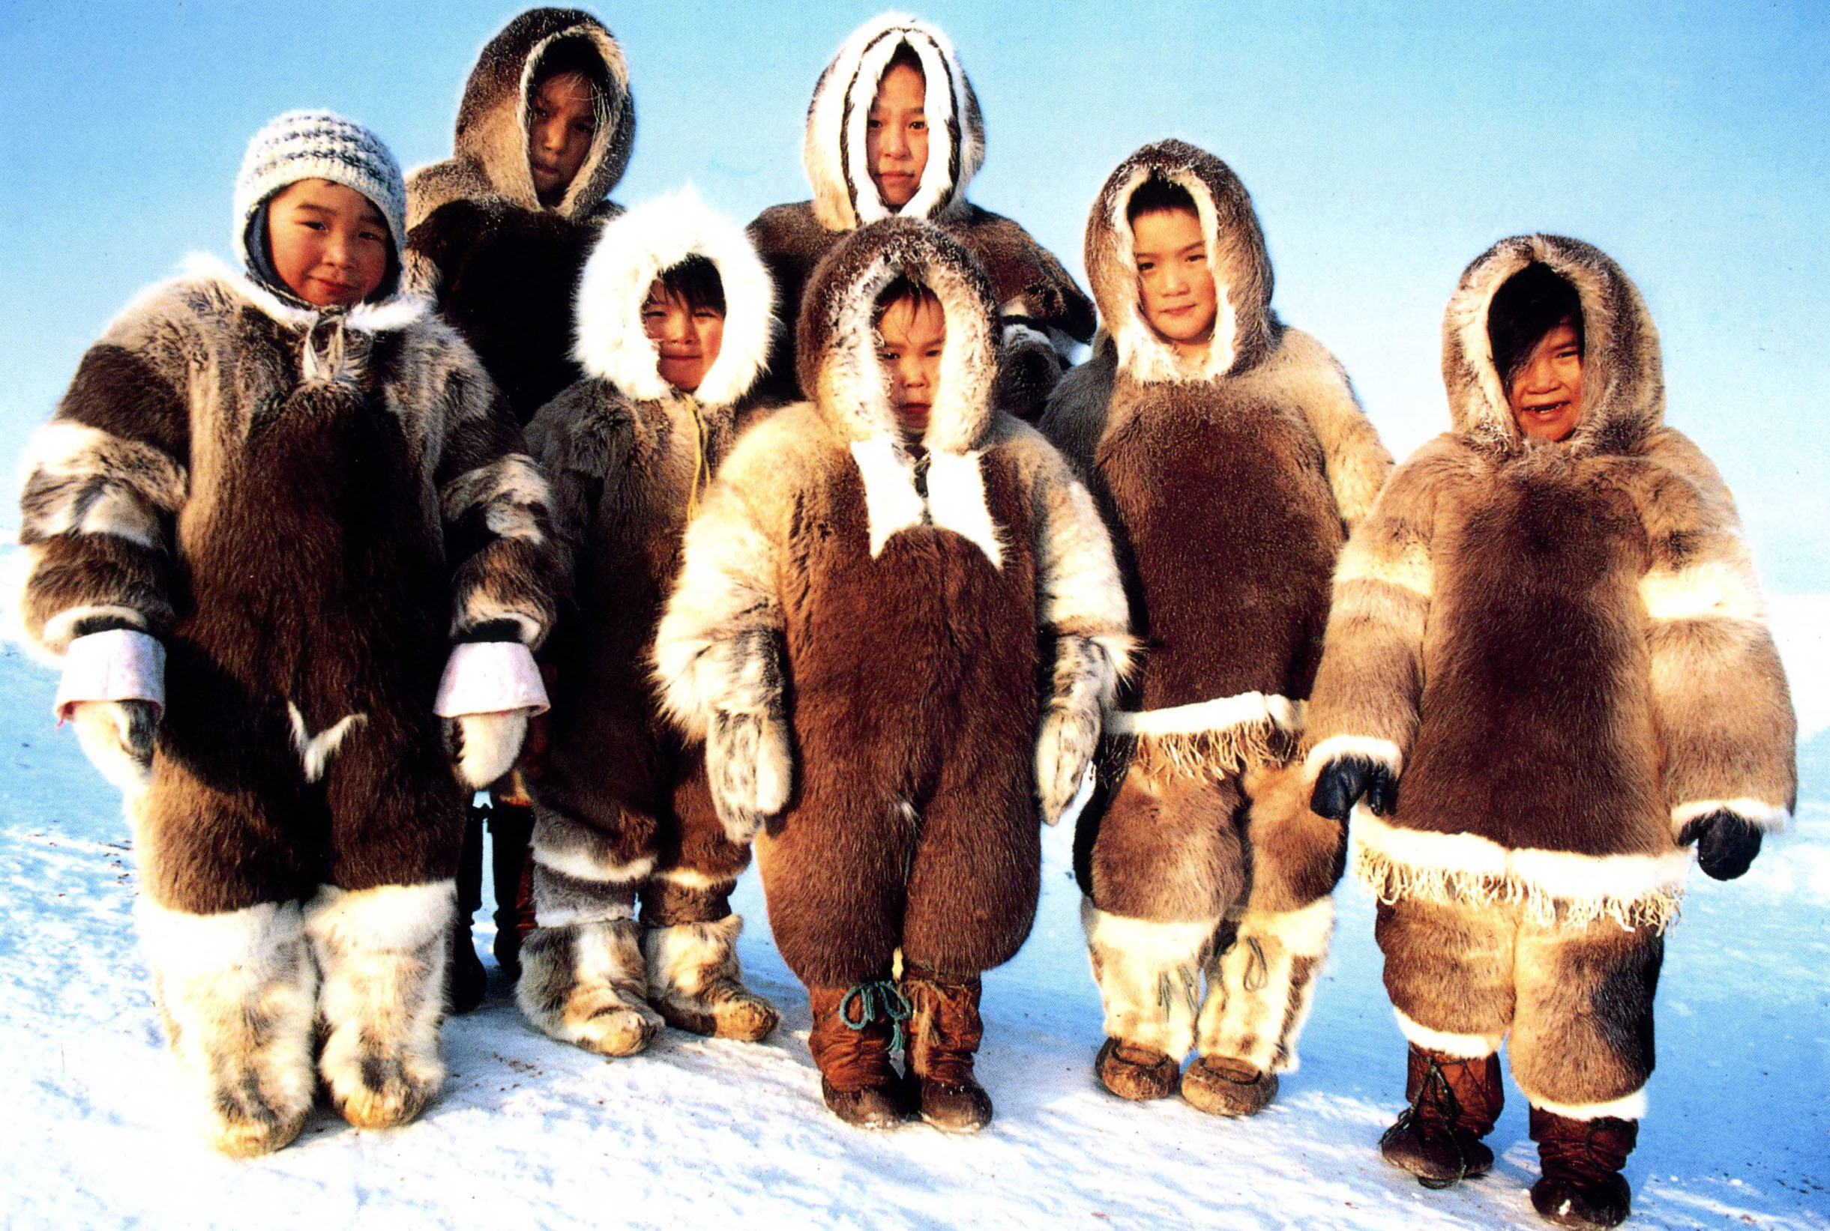
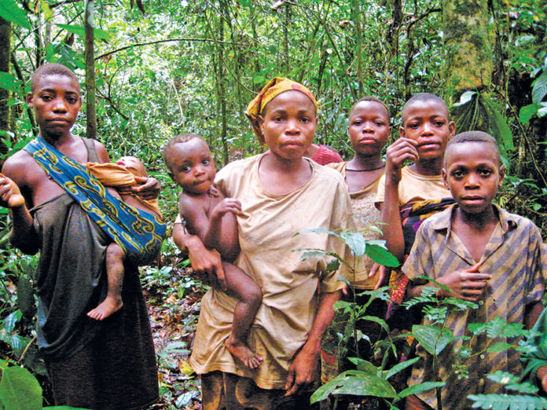
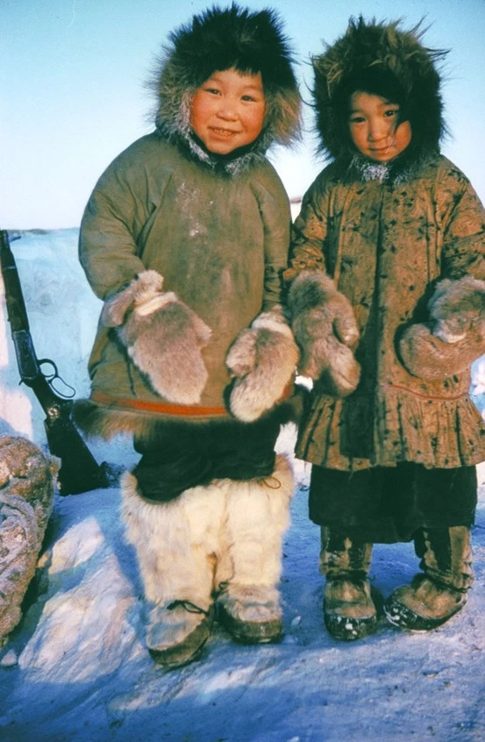
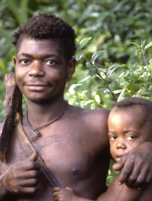
Comparison of NOMANDIC tribes
Nomadic tribes are very different. They live differently because in different places around the world. Dressed differently, they eat differently, but their common feature is the nomadic lifestyle.
Innuits
Pygmies

Slide 6
Thanks! That’s all :)
Gosia Kant 7B

